Slide 1
Page Replacement Algorithms
Joseph Charamut

Slide 2
Cache Replacement Algorithms
I implemented the FIFO, Random, and LRU cache strategies
I was planning on adding the Optimal cache strategy but ran out of time

Slide 3
Results 1
For the pattern "01201303121", LRU and Random had the best scores of a 55% hit rate, while FIFO only had 36%.

Slide 4
Results 2
For the pattern "01201303121012013031210120130312101201303121", LRU and Random had the best scores of a 68% hit rate, while FIFO only had 57%.

Slide 5
Program Structure

Slide 6
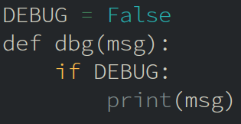
Debug Logging
I made a function to turn on and off extra logging in the functions so I wouldn't have to comment out a lot of print statements after I finished testing.

Slide 7
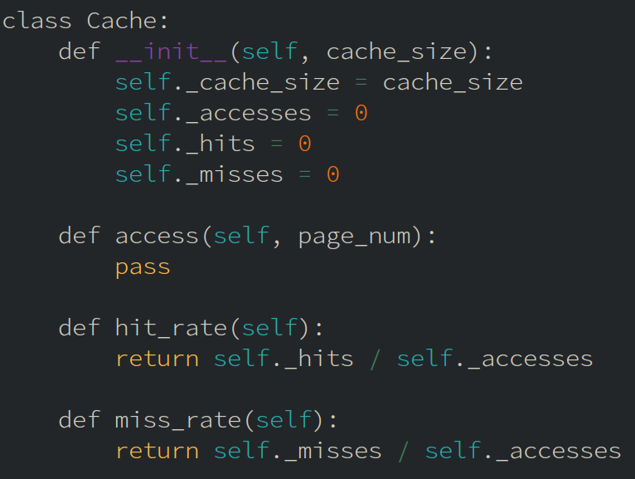
Base Cache Class
To start, I created a base class for all the cache methods.
This includes all the common statistics for the cache like the accesses, hits, and misses.
There is a common method to access a page that each subclass overrides.
I added methods to get the hit and miss rate also.

Slide 8
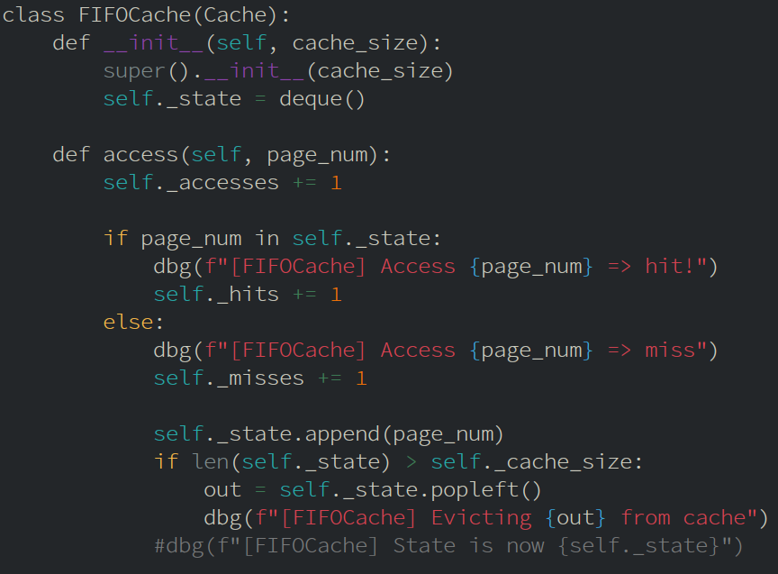
FIFO Cache
I implemented the FIFO cache using Python's deque container.
I'm using it as a queue, using append() to add to the right side and popleft() to remove from the left side.

Slide 9
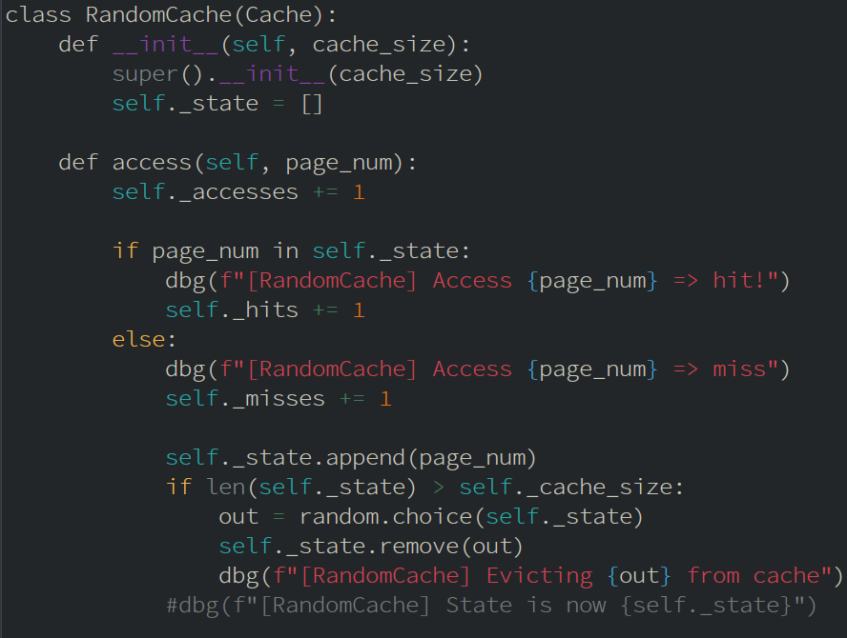
Random Cache
For the Random cache, I used python's random.choice() function to select a random element from the list of pages in the cache to remove.

Slide 10
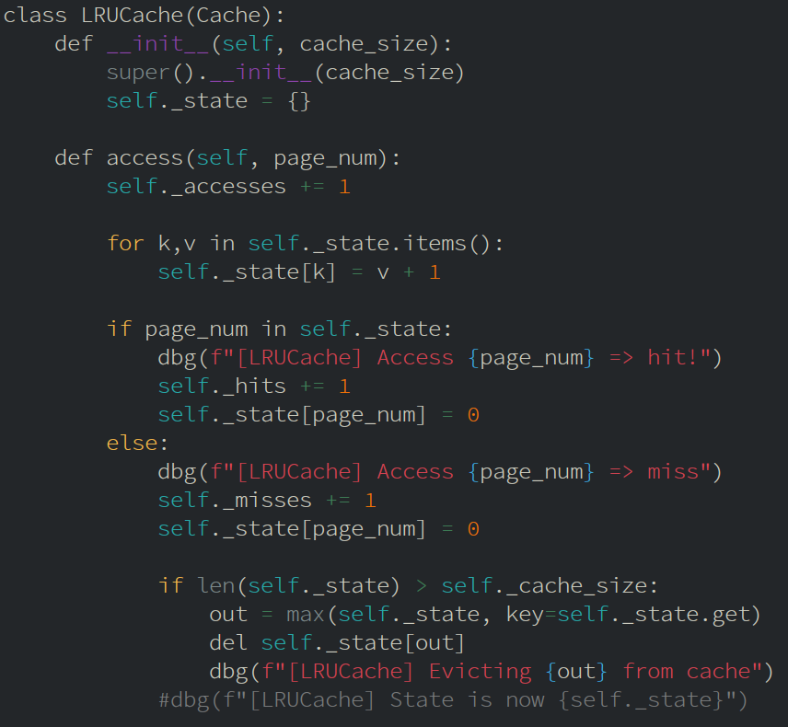
LRU Cache
I implemented the LRU cache algorithm using a dict in python.
This is not an efficient way to implement it but it works fine for a demo.
Every time a page is accessed, all pages in the cache have their score incremented.
On a hit, that page gets reset to 0, otherwise it evicts the least recently used page if necessary.

Slide 11
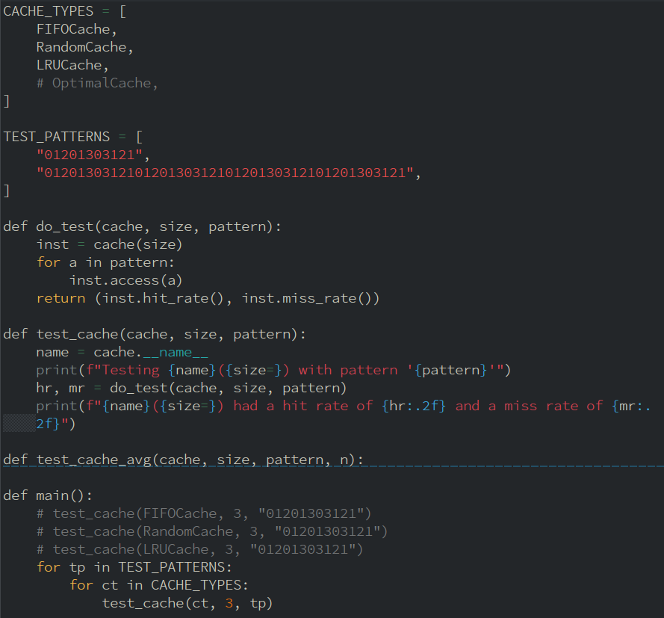
Test Framework
I have a list of the types of cache methods to test, and a list of patterns to test them with.
In main, I call test for each type and pattern to gather test data for all combinations.

Slide 12
The End

